Slide 1
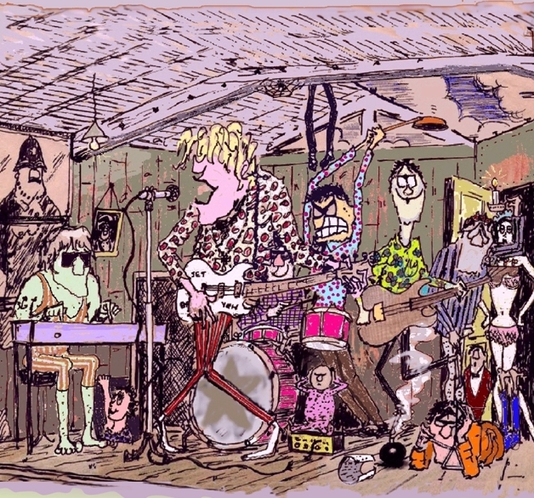
Notes:
Morganisation. Next up: Buddy

Slide 2
Notes:
Buddy – stills for showing behind ‘Peggy Sue got married’ No sound output needed for this one!

Slide 3
Notes:
Morganisation. Next up: Something-shortie

Slide 4
Notes:
Something –shortie 0:42
Run on mention in interview... (after Roy Wood, Carl Wayne)
Don Arden & The Move’s next record

Slide 5
Notes:
Morganisation. Next up: Benediction

Slide 6
Notes:
Benediction

Slide 7
Notes:
Morganisation. Next up: Girl in a Jaguar

Slide 8
Notes:
Girl in a Jaguar

Slide 9
Notes:
Morganisation. Next up: Normal Day

Slide 10
Notes:
Normal Day

Slide 11
Notes:
Morganisation. Next up: Mission Impossible

Slide 12
Notes:
Mission Impossible

Slide 13
Notes:
Morganisation. Next up:

