Slide 1
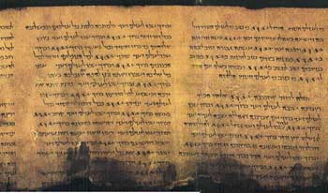

Slide 2
Mat 15:13
… Every plant, which my heavenly Father hath not planted, shall be rooted up.

Slide 3
TWO EVENTS
ONE SCRIPTURE

Slide 4
Isa 54:9
For this is as the waters of Noah unto me: for as I have sworn that the waters of Noah should no more go over the earth; so have I sworn that I would not be wroth with thee, nor rebuke thee.

Slide 5
Isa 54:10
For the mountains shall depart, and the hills be removed; but my kindness shall not depart from thee, neither shall the covenant of my peace be removed, saith the LORD that hath mercy on thee.

Slide 6
Gen 3:22-23
And the LORD God said, Behold, the man is become as one of us, to know good and evil: and now, lest he put forth his hand, and take also of the tree of life, and eat, and live for ever:
Therefore the LORD God sent him forth from the garden of Eden, to till the ground from whence he was taken.

Slide 7
WHY?
Gen 6:5 And GOD saw that the wickedness of man was great in the earth, and that every imagination of the thoughts of his heart was only evil continually.
6 And it repented the LORD that he had made man on the earth, and it grieved him at his heart.
7 And the LORD said, I will destroy man whom I have created from the face of the earth; both man, and beast, and the creeping thing, and the fowls of the air; for it repenteth me that I have made them.

Slide 8
Gen 6:3
And the LORD said, My spirit shall not always strive with man, for that he also is flesh: yet his days shall be an hundred and twenty years.

Slide 9
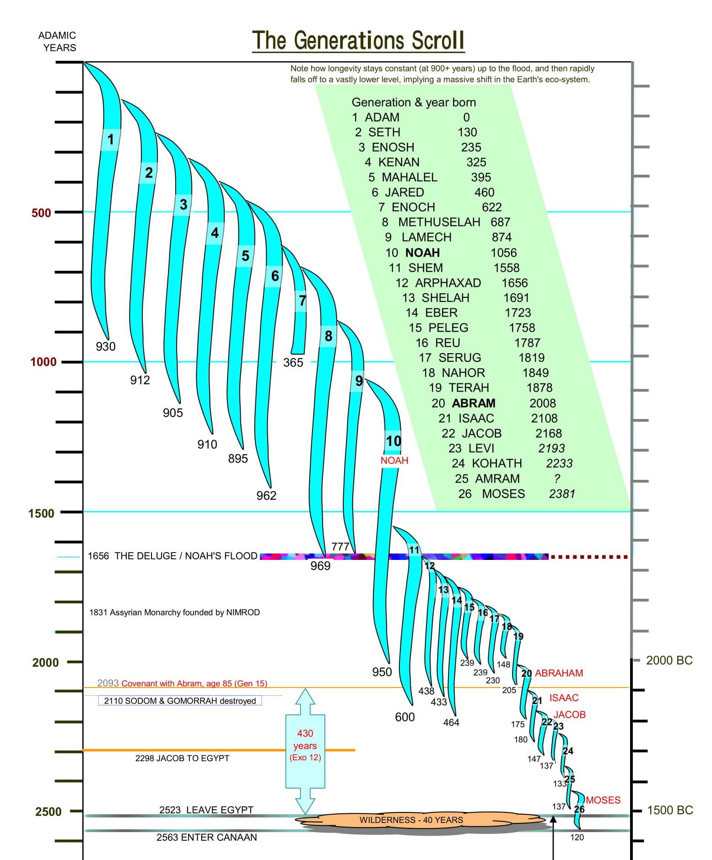
HOW?

Slide 10
Psa 90:7-9
For we are consumed by thine anger, and by thy wrath are we troubled.
Thou hast set our iniquities before thee, our secret sins in the light of thy countenance.
For all our days are passed away in thy wrath: we spend our years as a tale that is told

Slide 11
Psa90:10
The days of our years are threescore years and ten; and if by reason of strength they be fourscore years, yet is their strength labour and sorrow; for it is soon cut off, and we fly away.

Slide 12
Psa 90:11-13
Who knoweth the power of thine anger? even according to thy fear, so is thy wrath.
So teach us to number our days, that we may apply our hearts unto wisdom.
Return, O LORD, how long? and let it repent thee concerning thy servants.

Slide 13
Psa 90
‘A prayer of Moses, the man of God’
‘God swore that only Joshua and Caleb would enter the land (Num 26)
Moses died age 120 (Deu 34)
Joshua died age 110 (Josh 24)

Slide 14
Psa 91:16
With long life will I satisfy him, and shew him my salvation.

Slide 15
Mat 15:13
… Every plant, which my heavenly Father hath not planted, shall be rooted up.

